Slide 1
Carl-Bot
Group 8-30
Owen Moogk, Eidan Erlich, Shabd Gupta, Richard Wang

Slide 2
Contents
1
3
2
4
Summary
Hardware Demo
Preliminary report update
Demonstration of current working product
Criteria / Constraints
Procedure / Schedule
Objectives that the robot can complete.
Our working plan

Slide 3
Summary
Report Update

Slide 4
Summary
From last time:
Chess playing robot
Execute moves inputted by the user
Changes since then:
Continuing the 2-axis carriage, with a claw
Modified the timeline
Design of the carriage axis is more difficult than we hoped, will require a bit more time.
Adding a color sensor to allow the robot to track position (motor encoder had too much drift / slip)

Slide 5
Criteria & Constraints
Project Metrics

Slide 6
Success Criteria
Track & locate the position of every piece on the board
Axial Movement
Move the carriage to each rank & file on the board
Piece pickup
Grasp and raise each piece upon actuation
Board Mapping
"Normal" movement
Move the claw across the claw across the board.

Slide 7
Constraints
Predetermined Criteria
Board Size & Position
Piece Size & Position
Movement
Size and Position

Slide 8
Physical System
Demo Time!

Slide 9
Frame
Tetrix
Aluminum
Fusion
Ski Track System
Lego
Beams

Slide 10
Axial movement
Rail System
Fixed Position Pulley System
2 Axis Movement
X-Axis
Y-Axis

Slide 11
Claw Actuation
Rack and Pinion
Augmented Tetrix Claw
Actuation

Slide 12
Joint Mechanism
Rails
Frame
Skis
Axial Movement
Claw
Vertical Movement
Claw Actuation
Movement Mechanism

Slide 13
Input Assembly
Touch
Axis Zeroing
Colour
Horizontal Movement
Motor Encoder
Fixed Pully
EV3 Buttons
User Input and Output
Game States I/O
File I/O
Large Motor
2-Axis Movement
Medium Motor
Vertical Movement
Tetrix Servo Motor
Claw Actuation

Slide 14
Precision
Fixed Initial Position
Zeroing Throughout
Deliberate Movement
Frame Mounted Touch Sensor
Incremental Colour Sensor
Piece Tracker

Slide 15
Process and Procedure
Demonstration Agenda

Slide 16
Test Procedure
Regular Operation
Start up / Shut down
Start up: Select game mode using EV3 button’s
Exceptional Operation
Illegal input
Caught Skis
Move selected is the initial position of piece
Shut-down: Press all EV3 buttons simultaneously
No movement recorded by colour sensor, return to “zero” and try again
Show move error, invalid input, get new input
If second attempt fails, return to zero and “gamestate” failed
Ignore any input during a move
Execute 5 moves consecutively & successfully
Successfully pick up and place the piece
Successfully “take” a piece and dispose of the taken piece
Take in user input
Accurately navigate to and pick up pieces
Use imported file to update game state
Output a file of the game played

Slide 17
Demo Day
System Start Up
Sensor Config
Game Initialization
Select game-mode (PvP / game review)
Gameplay
Axis Zeroing
Movement check
Shabd vs. TA
Review the game
Case Handling
During gameplay
Game over / Shutdown Procedure
Prompt for new game
Initiate Shutdown procedure
Move to Zero

Slide 18
Timeline
Deadline Progress, Key Milestones

Slide 19
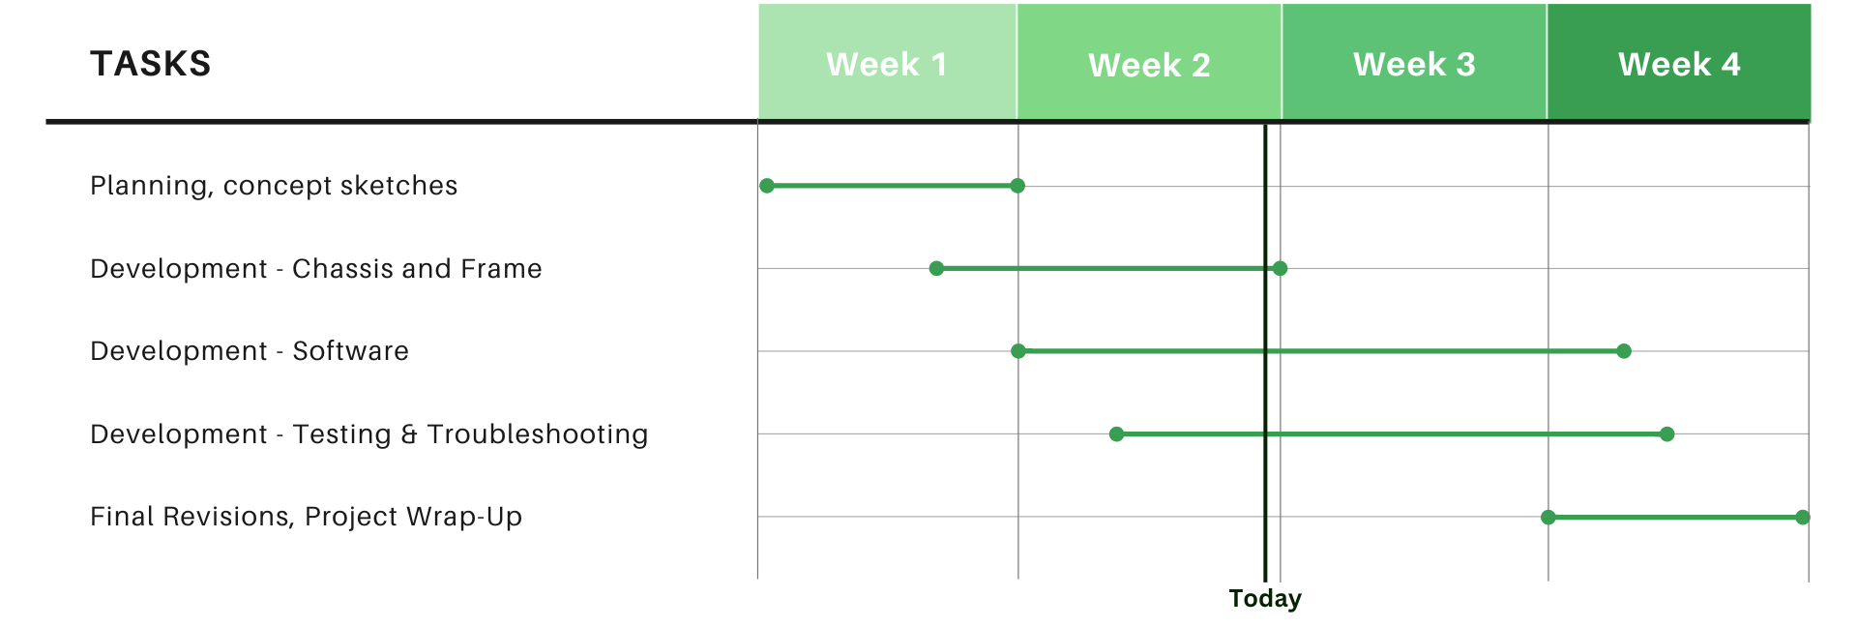
Timeline

Slide 20
Timeline – Progress
Tasks Completed
Concept sketches
Project planning
Frame
Y-axis carriage
X-axis carriage
Claw carriage movement
Tasks To-Do
Claw redesign (3D Print)
Claw actuation
Chessman movement
Basic game logic
Puzzle mode
Match replay
Advanced game logic

Slide 21
Timeline – Key Milestones
Week 1
Concept sketches and planning
Finish building frame
Week 2
Chassis can move to any square on the board
Claw can pick up pieces and move them to any square
Week 3
Basic game logic working
Puzzle mode working
Week 4
Full game of chess can be played
Game replay and advanced game logic working?
Finish final report

Slide 22
Our Questions
How much time do we have to demonstrate the final product?
Thoughts on the hardware system? Any recommendations?

Slide 23
Thanks
Questions for us?

